Slide 1

Discussion document Industry due diligence July, 2024
Jul 09, 2024

Slide 2
Content
Context and objectives
Proposed methodology
Why IOTA Impact
Team IOTA and timeline
Proposed investment
01
02
03
04
05

Slide 3



Odevo - a leader in residential property management services - is seeking a comprehensive understanding of the market size, client base, and competitive landscape to guide an evaluation of a potential strategic acquisition.
IOTA will support Odevo's mission to enhance living standards through digital transformation and sustain its rapid growth. The insights gained will enable Odevo to determine the size of the opportunity in developments above 2k units, the customer needs in the segment, and the potential strategic adjacencies of the services provided by this specific segment and company. This will help decide if Odevo continues with the process of evaluating an aquisition.
Context and Objectives
Objective 1: Determine the current market size (TAM, SAM) and market share of the target by state and potential market growth within the services provided to large developments.
Objective 2: Gain in-depth insights into the specific requirements and challenges faced by clients within the segment.
Objective 3: Evaluate strategic adjacencies to provide other services to these clients.

Slide 4
Content
Context and objectives
Proposed methodology
Why IOTA Impact
Team IOTA and timeline
Proposed investment
01
02
03
04
05

Slide 5


Proposed Timeline: 5 weeks divided into 2 main phases
Phase 1 – 3 weeks
Phase 2 – 2 weeks
Comprehensive analysis of market and client needs,.
Identify strategic adjacencies and opportunities to use target as a springboard to offer additional services.
Objective by phase
Comprehend the market size Determine the current market size (TAM, SAM) and market share of the target by state and potential market growth within the services provided to large developments.
Gain in-depth insights into the specific requirements faced by large developments, how the current solutions meet their needs and the pain points they currently have
Evaluate strategic opportunities through discussions with experts and working sessions to identify opportunities and determine their potential for driving growth and innovation.
Recommend a prioritization of efforts based on a high-level assessment of their feasibility, impact, and alignment with Odevo's strategic goals.
Execution details
Client interviews: Conduct 50 in-depth interviews with residential complex managers of more than 2k units to uncover critical insights into their operational needs, expectations from property management services, current challenges, and the performance of existing service providers.
Industry expert interviews: Engage with 25 industry experts to gain a nuanced understanding of the market size, trends, innovations, and the overall dynamics within the property management services sector.
Secondary data collection: Compile and analyze secondary data sources, including industry reports and relevant publications, to identify emerging trends in consumer behavior and understand offerings from competitors and other players.
Market size estimates: create a model and estimate size of the opportunity by service, TAM and SAM by state, and market share of the target company.
Ideation Workshops: Facilitate interactive workshops with the Odevo team to collaboratively assess the strategic opportunities based on the data gathered in phase 1. These sessions will focus on brainstorming, evaluating, and prioritizing initiatives based on feasibility and potential impact.
Adjacency assessment: Synthesize the insights from the market analysis and workshops to understand prioritized adjacencies. This high-level assessment will be tailored to guide Odevo's acquisition efforts, ensuring alignment with market needs and competitive advantages.

Slide 6
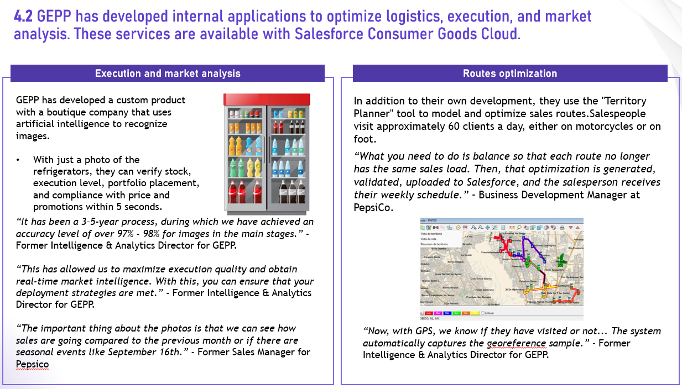
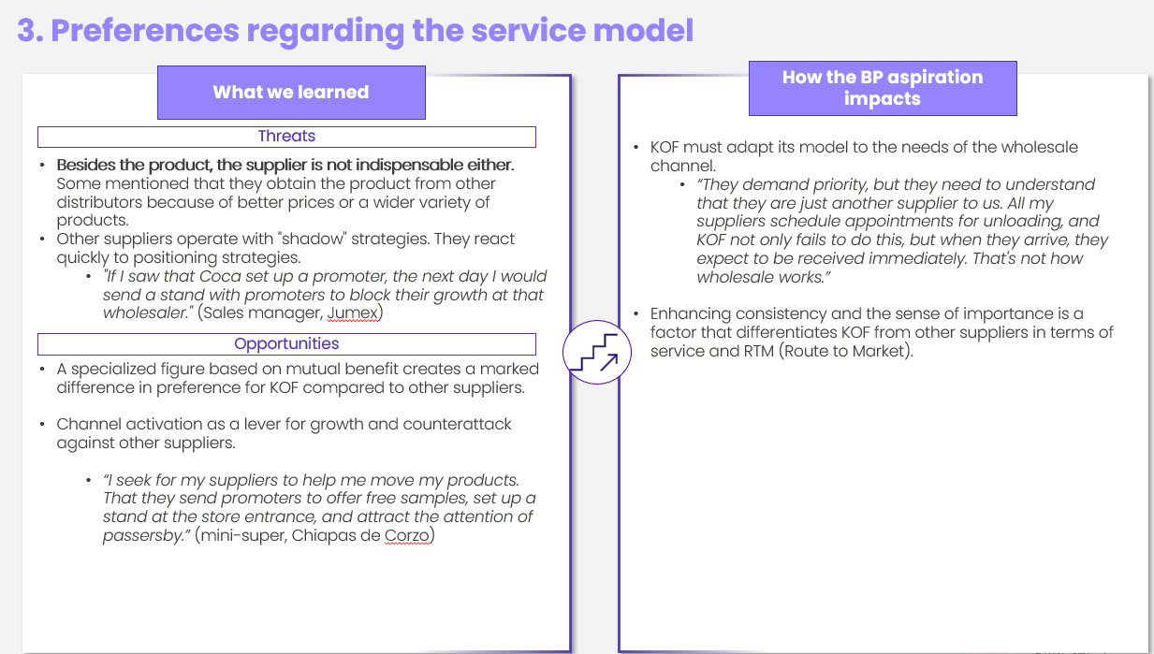

Deliverable – Summary of understanding and analysis of expert opinion
Action details
METHODOLOGY
25 EXPERT INTERVIEWS:
Virtual video conference
Duration: 1 hour
Profile: Qualified experts with extensive experience in residential property management, services and general real estate trends for large developments above 2k units. Gain deep knowledge of market dynamics, client needs, and competitive strategies. Specialists are senior executives and thought leaders with a proven track record in market trends and innovation within the sector.
Main Topics:
Market trends and growth opportunities: Explore trends in the residential property management market and identify areas with of growth.
Client needs and pain points: Discuss the primary needs, challenges, and expectations of clients (property owners, associations, and residents).
Competitive landscape: Evaluate the strengths, weaknesses, and market positioning of key competitors.
Innovation and best practices: Identify innovative practices and successful strategies implemented in the sector to improve efficiency, customer satisfaction, and competitive advantage.
Outlook and strategic priorities: Discuss future industry developments and strategic priorities that companies should focus on to stay ahead in the evolving market
1a
PHASE
Market size analysis
Duration: 2 weeks.
Market diagnosis based on expert opinions.
Summary of insights and implications for Odevo.
Detailed results of the interviews (recordings, transcription and summary)
Objective of the phase: Market Analysis
Comprehend the market size to determine the current and potential market opportunities to strategically position Odevo for growth and expansion.

Slide 7
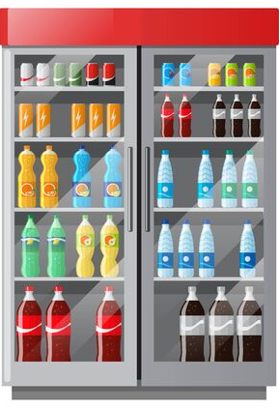
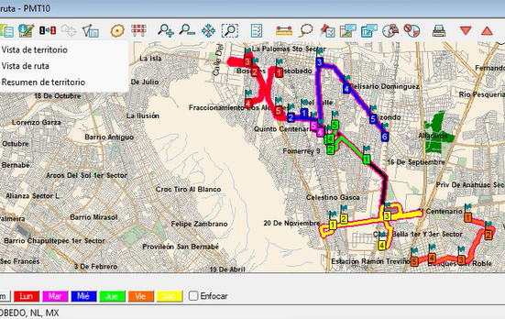
Examples of Interview results for a food and beverage company conducting market analysis
Example
Key themes emerging from the interviews and other research
CONTENT ADJUSTED TO PROTECT CONFIDENTIALITY
Execution and market analysis
Routes optimization
GEPP has developed a custom product with a boutique company that uses artificial intelligence to recognize images.
With just a photo of the refrigerators, they can verify stock, execution level, portfolio placement, and compliance with price and promotions within 5 seconds.
In addition to their own development, they use the "Territory Planner" tool to model and optimize sales routes.​Salespeople visit approximately 60 clients a day, either on motorcycles or on foot.​
“What you need to do is balance so that each route no longer has the same sales load. Then, that optimization is generated, validated, uploaded to Salesforce, and the salesperson receives their weekly schedule.” - Business Development Manager at PepsiCo.
Objective by phase
“It has been a 3–5-year process, during which we have achieved an accuracy level of over 97% - 98% for images in the main stages.” - Former Intelligence & Analytics Director for GEPP.
“This has allowed us to maximize execution quality and obtain real-time market intelligence. With this, you can ensure that your deployment strategies are met.” - Former Intelligence & Analytics Director for GEPP.
“The important thing about the photos is that we can see how sales are going compared to the previous month or if there are seasonal events like September 16th.” - Former Sales Manager for Pepsico
Execution details
“Now, with GPS, we know if they have visited or not... The system automatically captures the georeference sample.” - Former Intelligence & Analytics Director for GEPP.

Slide 8
Examples of Interview results for a luxury cruise company understanding opportunities
Example
Key themes emerging from the interviews and other research
CONTENT ADJUSTED TO PROTECT CONFIDENTIALITY
The affluent-travel population is comprised of deal-seekers, convenience-valuers, and brand-loyalists.
Cruise Line X’s one & dones are mostly deal-seekers. Several on Cruise Line X’s prospect list are too.
Others are convenience-valuers who need variety, more time, or were turned off by a poor experience with Cruise Line X.
The majority (~70%*) of affluent travelers have never cruised, while only ~3% have experienced a luxury cruise
People who have never cruised have objections, and some such as fear of “cabin-fever”, “seasickness”, “being bored”, and “lack of flexibility” can be addressed
Most affluent travelers who have never explored luxury cruising or Cruise Line X would find it satisfies several of their travel needs such as itinerary, convenience, luxury, and personalization
Luxury-cruise travelers have a highly heterogeneous set of needs and preferences
Luxury cruise travelers are a heterogenous group and have a wide range of needs (e.g., itinerary, cabin, excursions, personalization, seamlessness and flexibility )
For luxury-cruise travelers, out of the myriad of factor driving choice and satisfaction, guests have highlighted key differentiators…(the service is the main one for Cruise Line X, and there’s details such as a high-tech ice-cream machine)
…and “can’t fumble” table-stakes. (a cheap wine bottle, one moment of “unfair” treatment, “intrusive upselling”, misrepresenting the itinerary or guest profile)
Travelers are overwhelmed by choice and want support in selecting and evaluating their options.
Travelers need a curated set of options from a trusted source that are easy to evaluate.
Travelers will always evaluate the bang for the buck and expect their booking provider to ease the selection and evaluation process.
For convenience valuers, there are expectations for luxury brands to communicate as such, consistently between channels.

Slide 9
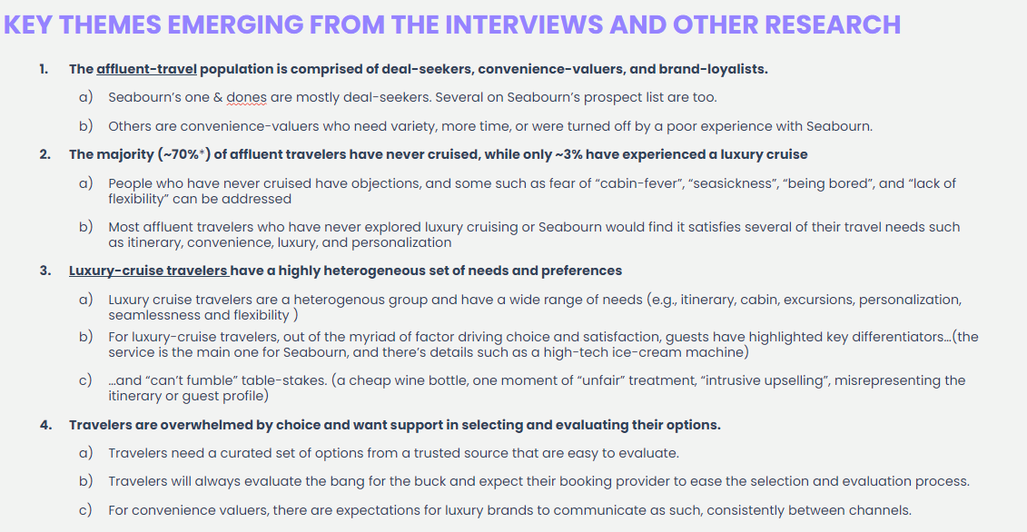
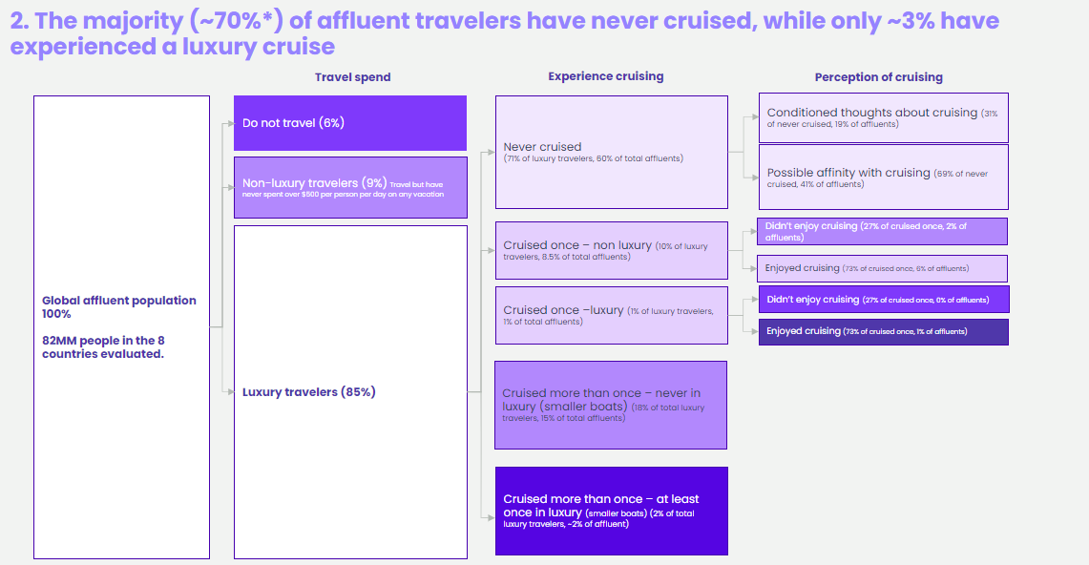
Deliverable – Summary of understanding and analysis of Odevo’s diagnosis
METHODOLOGY
Action details
1b
PHASE
10 INTERNAL INTERVIEWS:
Virtual video conference (Teams or Zoom)
Duration: 45 min to 1 hour, per interview
Selection: roles in strategy and operations within the company.
Main Topics:
Current market understanding: Assess the perspectives on market trends, client needs, and competitive dynamics to gauge the company's current market understanding.
Challenges and pain points: Identify the key challenges and pain points the company faces in achieving its objectives.
Expectations and success metrics: Discuss the company's expectations for the study and the metrics they consider critical for measuring success and driving continuous improvement.
Note: The insights from the interviews will not be attributed to specific individuals to preserve the privacy and sensitivity of the respondents.
Market size analysis
Duration: 1 week.
Market diagnosis based on internal opinion.
Analysis of interview data highlighting key insights from internal stakeholders.
Summary of insights and implications for Odevo.
Objective of the phase: Market Analysis
Comprehend the market size to determine the current and potential market opportunities to strategically position Odevo for growth and expansion.

Slide 10
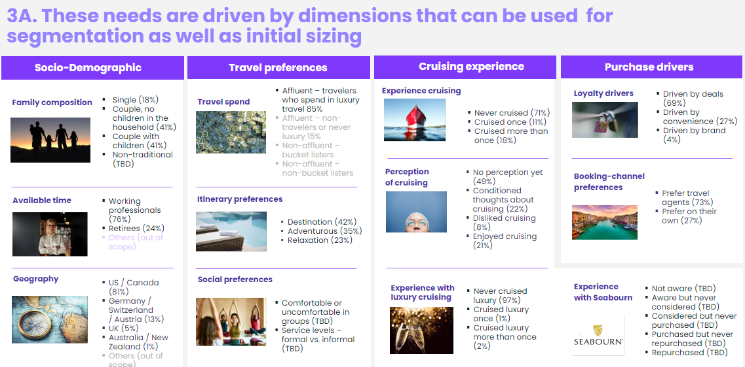
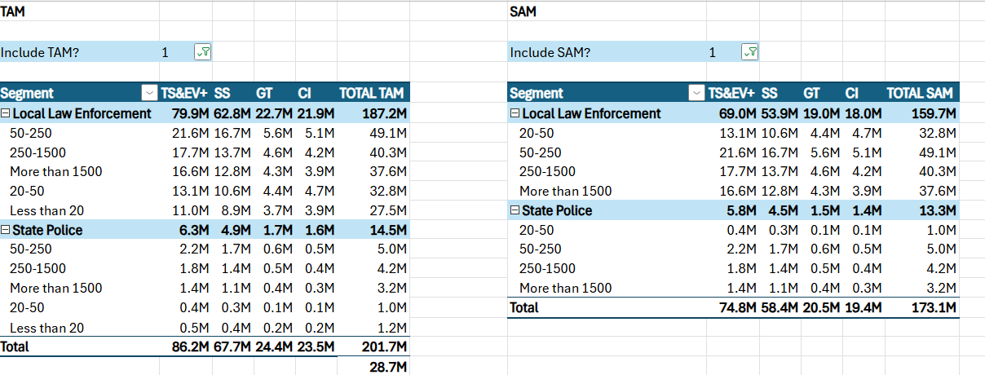
Deliverable – Summary of understanding and analysis of secondary research
METHODOLOGY
Action details
1c
PHASE
SECONDARY RESEARCH:
Web mining and content analysis to identify and quantify shifts in competitors' strategies and industry benchmarks.
Analysis of secondary data on the current market size, growth projections, and key players.
Collect and review data on competitors through their websites, press releases, benchmarks, databases and case studies to evaluate their strategies, strengths, and market positioning.
Tools: Use of analytics platforms and social listening tools to aggregate and analyze data.
Sources: Industry reports, review forums, social media, and other relevant online content that reflect market behavior.
MARKET SIZING MODEL:
Market size estimates: create a model and estimate size of the opportunity by service, TAM and SAM by state, and market share of the target company.
Market size analysis
Duration: 2 weeks.
Executive Summary with findings and recommendations.
Breakdown of all the data collected, includes Excel files and additional reports that fed the secondary research.
Objective of the phase: Market Analysis
Comprehend the market size to determine the current and potential market opportunities to strategically position Odevo for growth and expansion.

Slide 11

TAM and SAM analysis for service provider to fire and law enforcement departments
Fire Departments opportunity by segment
CONTENT ADJUSTED TO PROTECT CONFIDENTIALITY
US$ MM
The greatest opportunity for growth is 50-250 Career segment.
Small mostly volunteer and medium volunteer are a significant opportunity, nevertheless the feasibility of adoption in smaller departments may be limited.
Note:
Around 70% of the departments in the 50-250 segment have less than 100 officers
Volunteer and Mostly volunteer prices are assumed to be 30% lower than career prices

Slide 12
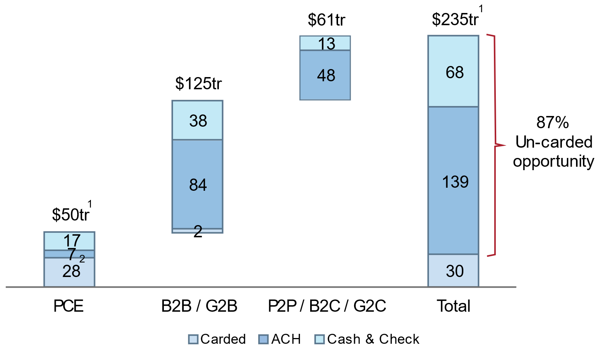
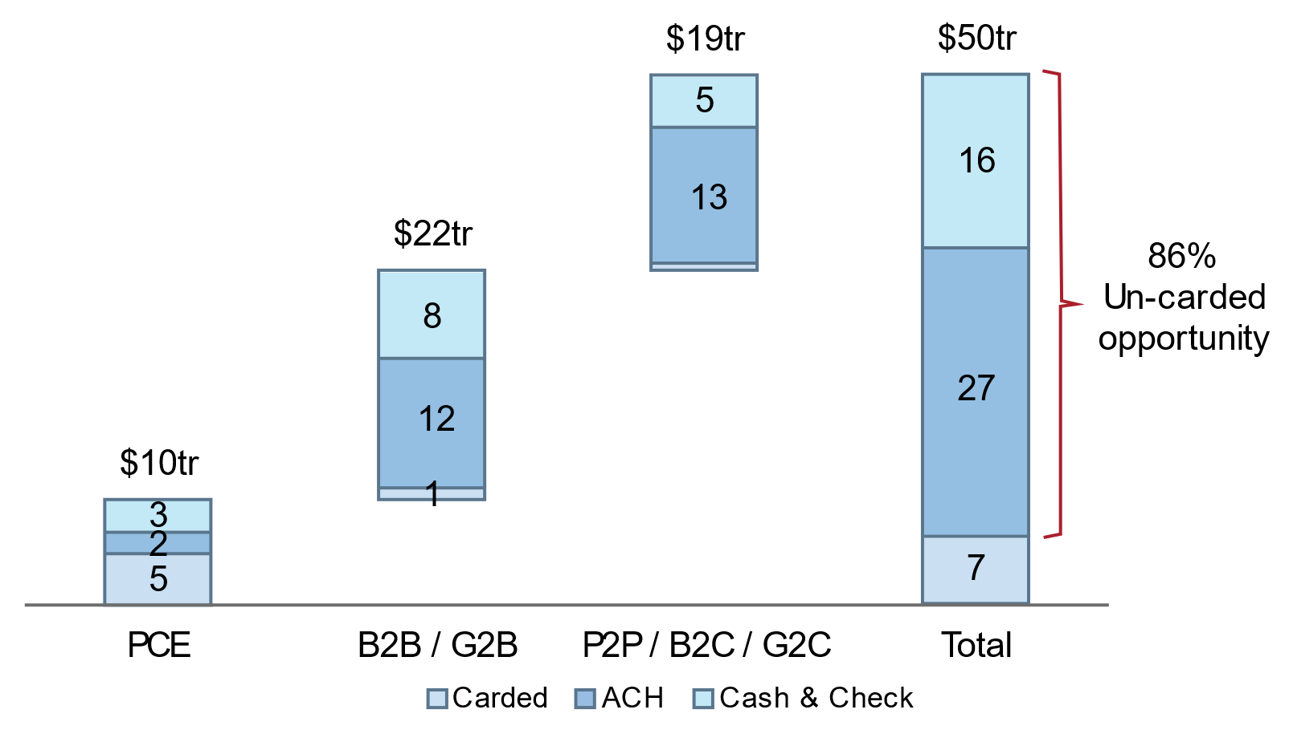
Examples of Interview results for a B2B payment company
Example
Global payments industry - Volume
CONTENT ADJUSTED TO PROTECT CONFIDENTIALITY
Global payments volume TAM is bigger than global GDP. “Global payments volume (~$240tr) is bigger than global GDP (~$85tr) because multiple payments are made for the same level of output or production.” – Credit Suisse
Global payments TAM (total addressable market) across carded,
ACH, and cash & check totals to ~$24tr, with only ~13% carded
The US payments market has a large TAM, estimated at ~$50tr in volumes when viewed in its entirety (PCE, B2B, G2B, P2P, B2C, and G2C), with ~50% + of consumer payments penetrated and ~5% of B2B
https://research-doc.credit-suisse.com/docView?language=ENG&format=PDF&sourceid=em&document_id=1083376791&serialid=Xv39ocygAc3ZfJnVd7%2Bd46T7aoIwVSA1Nyw3xJ%2Fgi0o%3D&cspId=null
https://www.mastercard.us/content/dam/public/mastercardcom/na/us/en/documents/business-payments-2022-whitepaper.pdf
https://web-assets.bcg.com/58/30/e7773b6a4c29b79b3673ab21ef66/bcg-global-payments-2021-report-all-in-for-growth-oct-2021-r.pdf

Slide 13
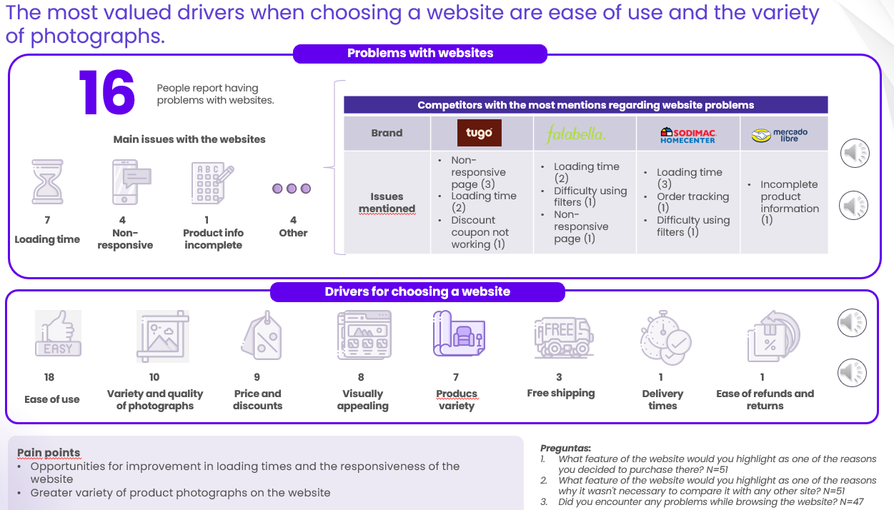
Deliverable – Foundational understanding of the client and analysis of the interviews
Action details
METHODOLOGY
50 CLIENT INTERVIEWS:
Virtual video conference
Duration: 1 hour
Profile: Residential complex managers and association board members with hands-on experience in property management, deep understanding of client needs and pain points, and familiarity with current service providers and industry challenges.
Main Topics:
Client needs and expectations: Understand the specific needs, expectations, and priorities of residential complex managers and association boards in property management services.
Pain points and challenges: Identify the primary challenges and pain points they face in managing properties and dealing with current service providers.
Provider selection criteria: Understand the criteria they use when selecting property management service providers and what factors influence their decision-making.
Innovative practices: Identify any innovative practices they have encountered or would like to see implemented in property management services.
1d
PHASE
Includes:
Market diagnosis, opportunities and implications for Odevo based on interviews.
Detailed results of the interviews (recordings, transcription and summary)
Market size analysis
Duration: 3 weeks.
Objective of the phase: Client understanding
Gain in-depth insights into the specific requirements and challenges faced by clients to tailor services and enhance customer satisfaction.

Slide 14

















Examples of Interview results for a furniture and home decor company
Example
The most valued drivers when choosing a website are ease of use and the variety of photographs.
CONTENT ADJUSTED TO PROTECT CONFIDENTIALITY
Problems with websites
16
People report having problems with websites.
Competitors with the most mentions regarding website problems
Brand
Issues mentioned | Non-responsive page (3) Loading time (2) Discount coupon not working (1) | Loading time (2) Difficulty using filters (1) Non-responsive page (1) | Loading time (3) Order tracking (1) Difficulty using filters (1) | Incomplete product information (1)
Main issues with the websites
7
4
1
4
Loading time
Non-responsive
Product info incomplete
Other
Drivers for choosing a website
18
10
9
8
7
3
1
1
Ease of use
Variety and quality of photographs
Price and discounts
Visually appealing
Producs variety
Free shipping
Delivery times
Ease of refunds and returns
Pain points
Opportunities for improvement in loading times and the responsiveness of the website
Greater variety of product photographs on the website
Questions:
What feature of the website would you highlight as one of the reasons you decided to purchase there? N=51
What feature of the website would you highlight as one of the reasons why it wasn't necessary to compare it with any other site? N=51
Did you encounter any problems while browsing the website? N=47

Slide 15
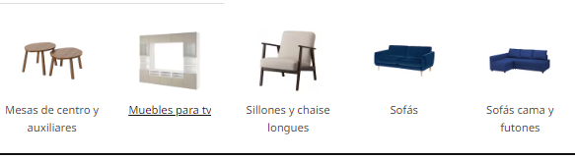
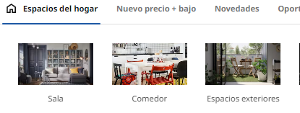
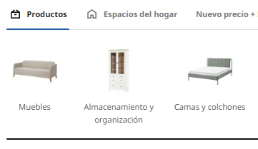
Most people prefer websites organized by product or by space.
Examples of Interview results for a furniture and home decor company
Example
CONTENT ADJUSTED TO PROTECT CONFIDENTIALITY
Product
Most people prefer this organization because it allows them to directly find what they are looking for.
"It is easier to compare what I need and makes exploration more efficient."
It is the more concise and therefore faster option.
"It seems more specific and simpler, not offering as many options as the space category."
And it ensures that they can compare all available options.
"It is easier to compare and see all types of the same product."
17
Furniture
Armchairs and chaise longes
Sofas
Space
The main reason for preferring this organization is that it is intuitive, and the buyer can reference objects within a specific environment.
"It allows me to see products organized in a way that I find more intuitive and logical.“
"If I'm talking about the home, it's easier to think about which products are found in each space."
Additionally, it allows for greater exploration to find complementary products and inspiration.
"I think it's good for getting inspired and having options on how to decorate my spaces."
3
6
8
2
14
Living room
Dining room
Outdoors
Category
This option is chosen by those who prefer the generality and variety of products, offering a broader exploration path that allows them to go from the general to the specific.
"The category should come before the product type, so I can go from the broadest to the most specific."
“Organization by category is broader and useful if the page then shows the details of that category."
Furniture
Storage and organization
Beds and matresses
Pain points
The current structure of the page excludes an organization that caters to a type of user with less specific search needs.
Question
If you had to choose a type of organization or filter to find a product, which would you consider better? N=50

Slide 16
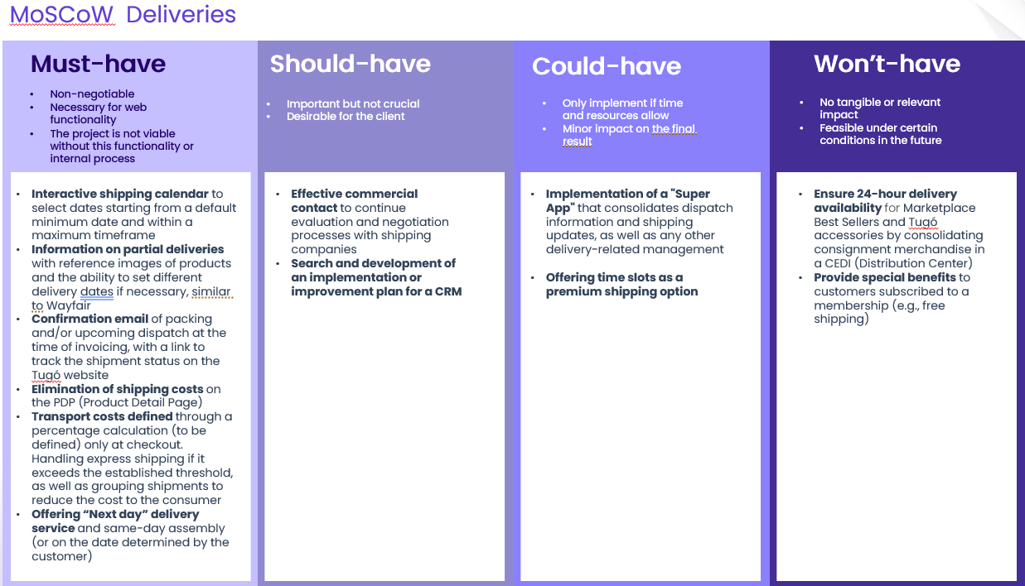
Deliverable – Prioritization of the opportunities
Action details
METHODOLOGY
2 WORKSHOPS:
Virtual
Duration: 1 hour
Profile of attendees: Roles that have an overview of the strategic visions, overarching goals, understanding of the market trends, client comprehension, and the competitive positioning.
Main Topics:
Discuss proposed strategic opportunities and prioritization: Identify and evaluate potential strategic opportunities. Prioritize these opportunities based on feasibility, impact, and alignment with Odevo's strategic goals.
Clients needs and enhancement: Brainstorm ideas for service enhancements and new offerings that can address these needs and improve client satisfaction.
Competitive landscape and differentiation: Opportunities to differentiate Odevo's offerings and establish a unique value proposition in the market.
2nd
PHASE
Includes:
Market diagnosis, opportunities and implications for Odevo.
Detailed results of the workshops (recordings, transcription and summary)
Ideation workshops
Duration: 2 weeks.
Objective of the phase: Strategic opportunities
Evaluate strategic opportunities to prioritize initiatives based on their feasibility, impact, and alignment with Odevo's strategic goals.

Slide 17
D2C approach can be coupled with the institutional approach to provide a high-value offer to the HED segment.
Examples of prioritization results for ed tech company
Example
CONTENT ADJUSTED TO PROTECT CONFIDENTIALITY
Communicating them in a way that has the highest appeal to the specific segment preferences and workflows
Branding towards the HED segment as THE place for jumpstarting your career in the areas that YOU want to work on
Advertising in social media: YouTube for all segments, and targeted advertising in TikTok for current students and dropouts younger than 24, and Instagram for graduates and older students and graduates.
Communicating the bang for the buck from a job perspective and testimonials in terms of employee placement and career switching impact
Providing a wide set of payment options and flexibility (some of which Ed Tech Co already offers)
Offering payment plans for employed graduates
Providing access to resources such as government and NGO grants to retrain, particularly for the most price sensitive individuals who are unemployed or underemployed
Evaluating ways to partner to provide loans
Exploring a risk-sharing component to the extent that it generates trust in the product without impacting financials significantly
Deepening the partnerships with institutions
Partnering with career services and academic advisors from institutions to build and deliver career content and benefits for current students and graduates
Associating with institutions as a pathway for dropouts to return to complete the degree by ensuring the student has a stable source of income and the discipline required to succeed
Partnership/endorsement with higher ed institutions (ideally a content partnership with an Ivy League) given their pedigree, that can then be distributed to community colleges and lower-cost schools that don’t have continuing education
…and defining whether Ed Tech Co will try to offer the for-credit offerings that the HED students would value significantly or avoid affecting most of the institutions that would not value it.¹

Slide 18
Recommended adjacent product portfolio for D2C
Examples of prioritization results for ed tech company
Example
CONTENT ADJUSTED TO PROTECT CONFIDENTIALITY
Product | Goal | Targeted cohort | Price | Attributes to include
Job premium product | Increase customer base and serve job-seekers / growers | Current HED | $1,500 | Non-credit or count as micro-degree Fully online (asynch or synch) Duration of ~2 months Placement support in addition to networking and/or career advisor services
Certified exam | Increase value for job switchers with or without careers | Graduates and Dropouts | $1,500-$2,500 | Vouchers for passing a certified exam Fully online (asynch or synch) Duration of ~2 months or offered as Bootcamp Offer placement support and networking
For-credit premium | Increase value for dropouts and current students who look to quickly learn skills outside of their major | Dropouts and Current HED | $1,500-$2,500 | Allied with trusted university brands Count toward credit in current and future programs Fully online synch. Or hyflex Duration of ~2 months Offer peer-to-peer support or instructor office hours Offer networking and/or career advisor services
Career advancement ultra-premium | Be THE provider for graduates who want to advance | Graduates | >$2,500 | Offer peer-to-peer support and instructor office hours Fully online or hyflex Duration according to student needs: bootcamps, 2+ months, 1 year Placement support, networking, and career advisor

Slide 19
Examples of Interview results for a furniture and home decor company
Example
MoSCoW Deliveries
CONTENT ADJUSTED TO PROTECT CONFIDENTIALITY
Must-have
Should-have
Could-have
Won’t-have
Non-negotiable
Necessary for web functionality
The project is not viable without this functionality or internal process
Important but not crucial
Desirable for the client
Only implement if time and resources allow
Minor impact on the final result
No tangible or relevant impact
Feasible under certain conditions in the future
Interactive shipping calendar to select dates starting from a default minimum date and within a maximum timeframe
Information on partial deliveries with reference images of products and the ability to set different delivery dates if necessary, similar to Wayfair
Confirmation email of packing and/or upcoming dispatch at the time of invoicing, with a link to track the shipment status on the Có website
Elimination of shipping costs on the PDP (Product Detail Page)
Transport costs defined through a percentage calculation (to be defined) only at checkout. Handling express shipping if it exceeds the established threshold, as well as grouping shipments to reduce the cost to the consumer
Offering “Next day” delivery service and same-day assembly (or on the date determined by the customer)
Effective commercial contact to continue evaluation and negotiation processes with shipping companies
Search and development of an implementation or improvement plan for a CRM
Implementation of a "Super App" that consolidates dispatch information and shipping updates, as well as any other delivery-related management
Offering time slots as a premium shipping option
Ensure 24-hour delivery availability for Marketplace Best Sellers and Có accessories by consolidating consignment merchandise in a CEDI (Distribution Center)
Provide special benefits to customers subscribed to a membership (e.g., free shipping)

Slide 20
Content
Context and objectives
Proposed methodology
Why IOTA Impact
Team IOTA and timeline
Proposed investment
01
02
03
04
05

Slide 21




The IOTA Differential.
At IOTA Impact, we steer and execute. Our rapid, data-driven insights accelerate ROI. We're more than strategy – we're your partners for market success.
As pioneers in automation and sustainability, we're your co-pilots for scalable success. That's the IOTA difference.
Our Partners

Slide 22







Strategic Agility, Enhanced Growth
Customized Tech Ecosystem Enhancements:
IOTA Impact's offerings are tailored to industry leaders providing strategic flexibility and responsiveness to dynamic market shifts.
1.
Data-Driven Tech Relevance:
We equip brands with actionable insights to stay pertinent and foster growth, regardless of the economic landscape, ensuring your team continues to lead in innovation and consumer connection.
Agile Market Intelligence:
Our agile market research methodologies empower swift decision-making, providing the competitive edge needed to excel without the burden of
excessive costs.
Culturally Attuned
Global Strategies:
We assist clients in integrating local consumer insights with global tech trends, guaranteeing a resonant message across diverse markets.
Innovation with Precision:
By harnessing our expertise in emerging technologies and semi-automated consulting, we offer innovative strategies that enhance market position through calculated, data-backed innovation.

Slide 23

Our capabilities benefit a wide variety of industries. Here are some examples from our IOTA Alliance clients.
Notes:
8

Slide 24
Content
Context and objectives
Proposed methodology
Why IOTA Impact
Team IOTA and timeline
Proposed investment
01
02
03
04
05

Slide 25









Team
Project management
Decision making
Barrier resolution
Tools and best practices experience
Industry and functional expertise and quality control
Andrés Satizabal
Jordi Monso
Alexander Curti
Engagement Directors and Sounding Board
Former McKinsey and research experts
Expertise
Agile work management
Hypothesis validation
Recommendations and quality control
Project manager expert in Market assessment and customer needs
IOTA Account Manager
TBD
Project Management
Data collection
Structuring and development of analysis and modeling
Technical analysis and development
Logistics
Specialized recruiters and interviewers
Secondary research specialists and tolos
Financial modeling expert
Design thinking expert
Internal coordinator – single point of contact
Internal list and information providers
Project Team

Slide 26
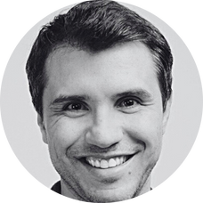
Project directors
Andrés Satizabal
CEO & founder IOTA Impact
With +23 years of experience in market research, analysis and consulting.
She has supervised more than 750 market research projects and more than 50 management consulting projects globally including due diligence including 10+ at McKinsey & Company (New York Office) and Advantis Consultoría Gerencial (OVAL Consultores) .
A graduate of NYU's Stern School of Business,.
Jordi Monso
Partner & Advisor at IOTA Impact
Expert in growth and strategy, with a focus on technology and analytics.
He has over 21 years of experience in consulting, developed at McKinsey & Company (New York), where he served as a partner and conducted due diligences.
Jordi holds an MS from the University of Catalonia and an MBA from New York University.

Slide 27
Project timeline
Project | Week 1​ | Week 2​ | Week 3​ | Week 4​ | Week 5​
Kick-off meeting​ | ​ | ​ | ​ | ​ | ​
Secondary research​ | ​ | ​ | ​ | ​ | ​
Internal interviews​* | ​ | ​ | ​ | ​ | ​
Expert interviews​* | ​ | ​ | ​ | ​ | ​
Client interviews* | ​ | ​ | ​ | ​ | ​
Workshops (2) | ​ | ​ | ​ | ​ | ​
Recommendations and report prep​ | ​ | ​ | ​ | ​ | ​
Hand-off​ | ​ | ​ | ​ | ​ | ​
Content review meetings | ​ | ​ | ​ | ​ | ​
* TIMELINE COULD BE EXTENDED 1 WEEK DUE TO SCHEDULING

Slide 28
Content
Context and objectives
Proposed methodology
Why IOTA Impact
Team IOTA and timeline
Proposed investment
01
02
03
04
05

Slide 29



Investment
Phase
Duration
Investment (US$)
Phase 1:
Secondary Research
10 internal interviews
25 expert interviews
50 client interviews
$ 90,000
3-4 weeks
Phase 2:
2 workshops
2 weeks
$ 15,000
TOTAL COST
$105,000
Considerations
Prices do not include VAT
Prices includes expert and customer incentives and the purchase of reports or databases
Unplanned schedule delays of more than one week by Odevo will cost an additional $10K per week
Proposal valid until July 25, 2024.

